Slide 1

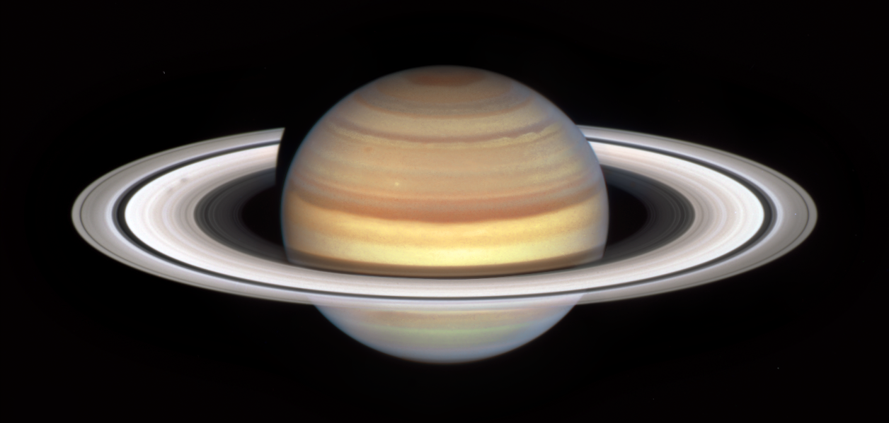
Ewell Astronomical Society – Nonsuch Park Planets Walk
8. Saturn
Basic facts
Diameter (1) kms (2) Earth radii
Mass – Earth masses
Distance from the Sun
Year
Day
Number of moons
The ringed planet Saturn [Image: NASA]
Description
Eg, 6th planet from the Sun, When discovered (known in ancient times), when were the rings discovered, what are they made of, coloured bands of clouds. Titan – second largest moon in the solar system – larger than the planet Mercury, has liquid lakes of methane on the surface, visited by the Cassini probe, Enceladus has water below an icy surface – water plumes have been detected
Fun Fact
Did you know that Saturn is largely made of hydrogen and helium – the two lightest elements in the universe. As a result Saturn is less dense than water, and, if you had a bathtub big enough, it would actually float!
Jupiter
Uranuss

